Slide 1
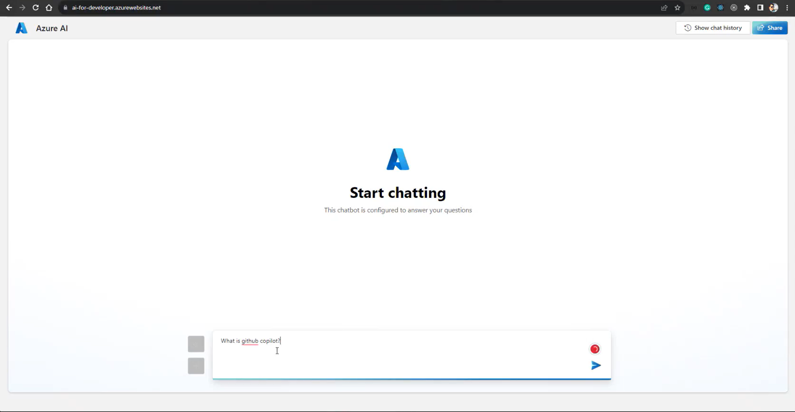

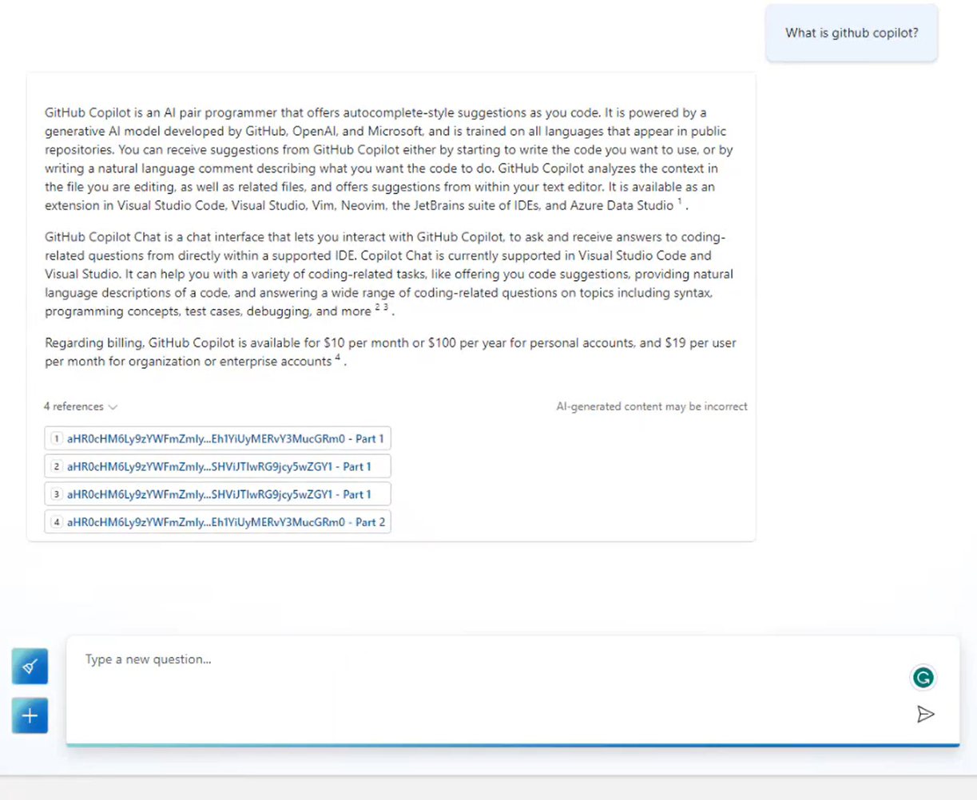
Microsoft AI Services – Chat Bot Development
Business Need
Microsoft came to Affirma for support in creating an AI Chat Bot to help guide Developers to key information and documentation on developer.microsoft.com.
What We Did
Affirma built the functionality with an Azure AI chat bot that uses OpenAI’s GPT-4 model. The chat bot was built in Azure AI studio and indexed on a custom Azure AI Search service.
It was integrated into the web UI and leveraged custom prompts to load relevant information based on UI elements as users scroll down the page.

